Slide 1
CAGA Storytelling Model for Engagement
By Mitzie Schafer
Deacon, CFRE, Consultant

Slide 2
Deposits Vs. Withdrawals Donor First

Slide 3
CAGA
CHANGE
AGENT of Change
GIFT that funded the agent of change
ASK for the next gift to fund the next agent of change

Slide 4
What to Listen For
Before the Change
What are the behaviors or feelings?
Agent of Change
What was done specifically and how was it provided by the agency?
Was it a program that a person carried out?
Was it a system of activities?
Was it intentional relationship building?
After the Change
What are the new behaviors or feelings?

Slide 5
Questions to Start With
How did you find/come to be part of?
Tell me about life before?
What are you most thankful for?
What was missing in your life before?
How long have you been involved?
Did you want to be here?
What were you looking for?

Slide 6
Questions to Get at the Agent of Change
What moment/person stands out the most for you as having an impact?
What made you stay here?
What means the most to you about?
How are things different for you now?

Slide 7
Questions for a Deeper Dive
Say more about that?
Can you say that differently?
What would you tell someone else considering?

Slide 8
Story Structure
Identify the Person(s)
1-2 Sentences that give an image of the person in the story
Before the Change
2-4 Sentences that give an image to the reader about where the person was in life.
Agent of Change
2-6 Sentences that explain what the organization offered that helped transform the person or make them feel belonging?
After the Change
2-6 Sentences that give an image to the reader where the person is now in life. Be clear about the change.
The Gift
1-3 Sentences about how giving to the organization paid for the Agent of Change.

Slide 9
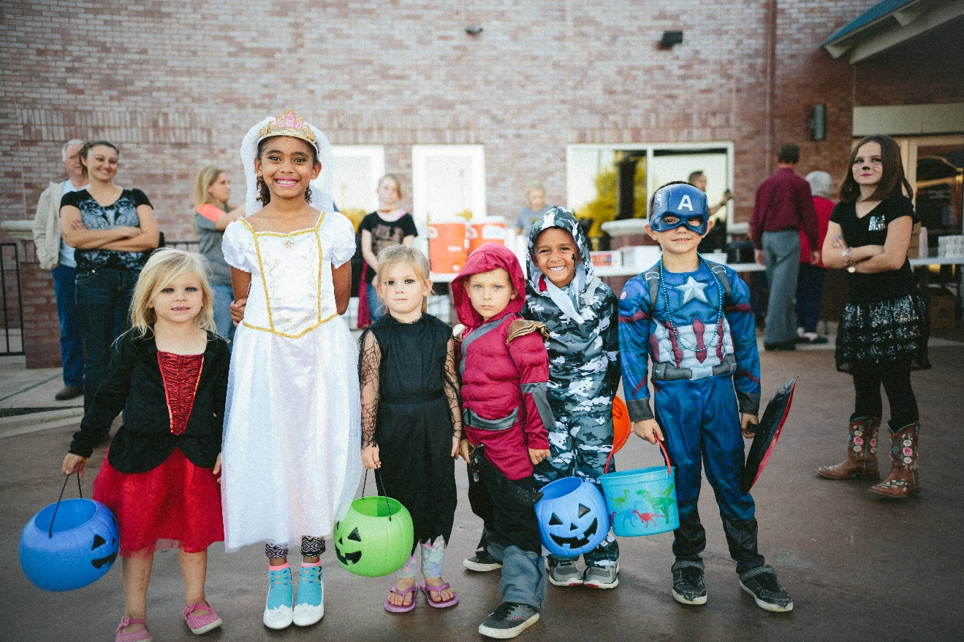
Capturing an Image
Clean your lens
Take close up pictures turned both ways
Make sure the camera is on jpeg
Capture Emotion

Slide 10
Avoid
Remember
Giving a life history or timeline
Giving the impression the person was interviewed
Including details that you thought were important but that distract from the CHANGE or AGENT of CHANGE
To always honor the dignity of the person
To make the CHANGE and the AGENT of CHANGE the focus

Slide 11
Strategically Communicated
Prevents reactionary or panicked messaging
Strategically tell your stories around emotional pivot times
Creates a repeatable and measurable system
Builds consistency with donors
Builds annual fund expectations & projections that help you plan your budget
Consistently promotes your organization

Slide 12
Interactions
Newsletters
Email
Social Media
Notes and cards
Ask letters
Events

Slide 13
Honest Evaluation
Does every word of your newsletter inspire giving and belonging?
Do your emails have an emotional draw?
What is your call to action (ONE primary)
Does social media encourage a “join me” culture?
Are you making enough deposits for the level of withdrawals?
Are your notes and cards personal? AND Timely?
Does your ask letter ask for impact or stuff?

Slide 14
Gratitude Grounded
As a Donor First model, we rate the value of telling the story equal to our sharing of gratitude for the donor’s response.
Gratitude shared provides a deposit each and every time.

Slide 15
Your Turn
Think of 1-3 people you think might have a story to tell. People who love your work or community.
Invite them each for a 30 minute interview.
Interview them using the CAGA model.
Draft a story for each of them using the CAGA model outline.
Email them to Mitzie at Mitzie@gsbfr.com

Slide 16
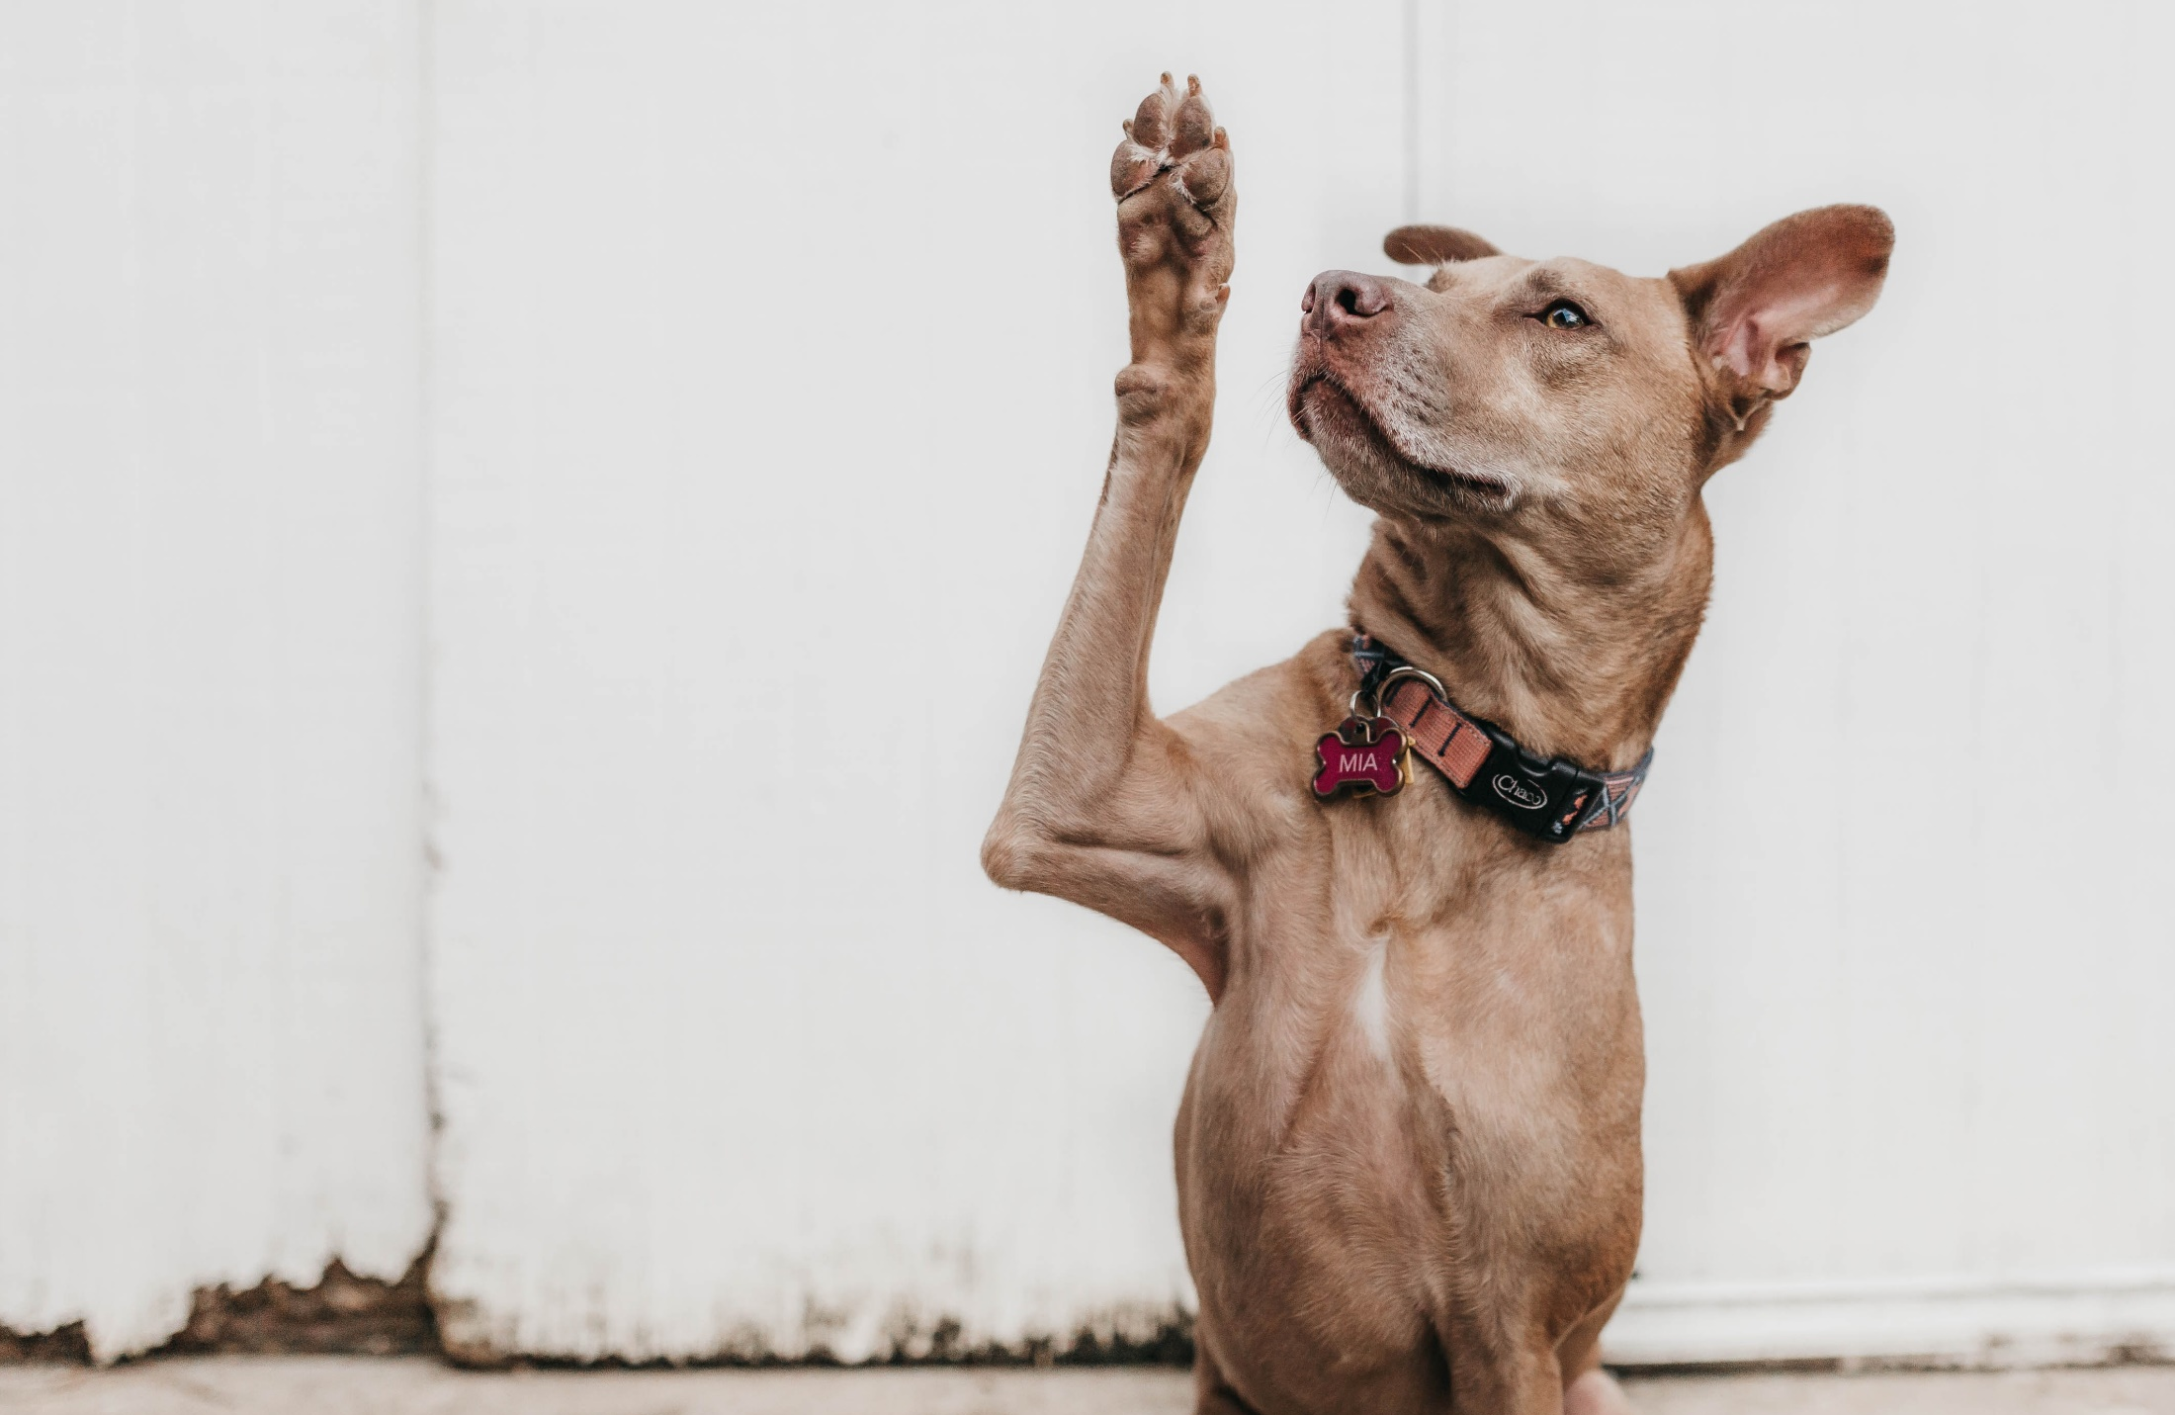
Questions?
Mitzie Schafer
CFRE, Consultant
803-413-7827
Mitzie@gsbfr.com

